Slide 1
Final Python Project
-Samyak rakesh meshram
-Nidhi shyamsundar berde

Slide 2
Dataset Used
NYC historical crimes (2010-2021)
-nyc.gov

Slide 3
Problem Definition:
This Dataset includes all valid felony, misdemeanor and violation reported to the New York City Police Department till the year 2021. After cleaning the data, we will analyze various crimes that happen in NYC, boroughs that are affected the most, location and time of crimes, Seasonal Crimes etc.
Based on data features, try to find out:
Main offence type
Borough where the crime took place

Slide 4
State of Data

Slide 5
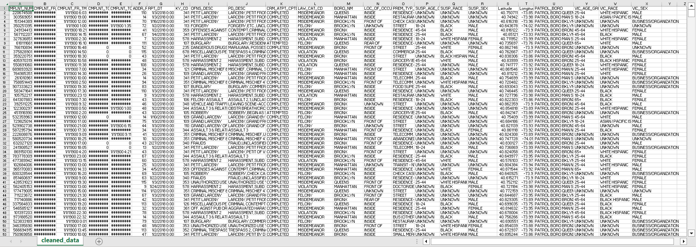

Slide 6
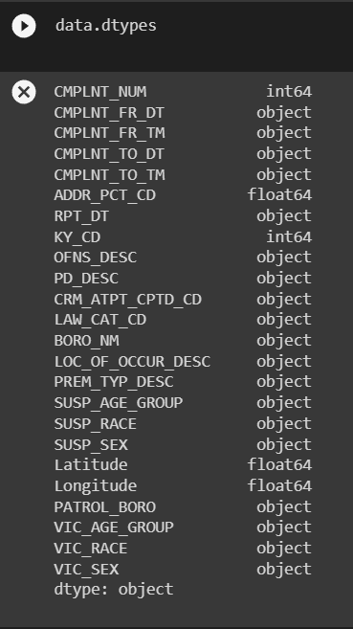
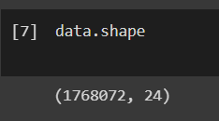
State of Data

Slide 7
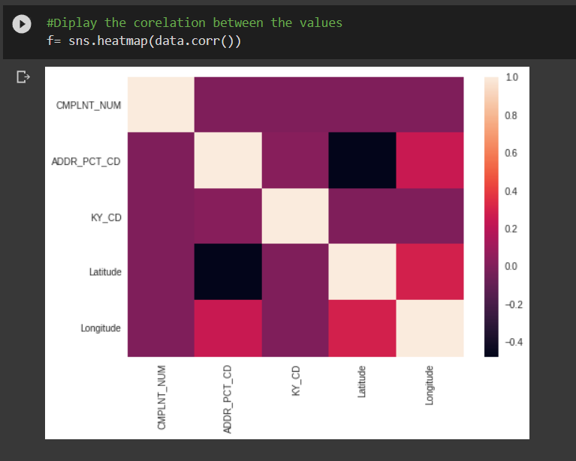
Data Heatmap

Slide 8
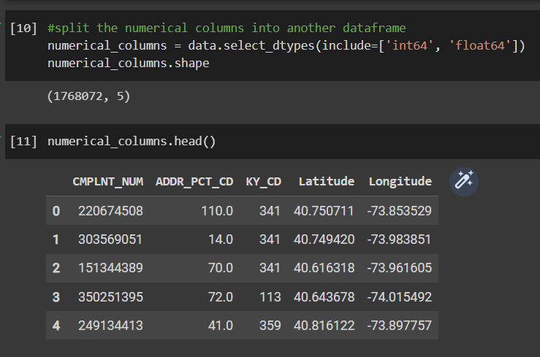
Separating Numerical Data

Slide 9
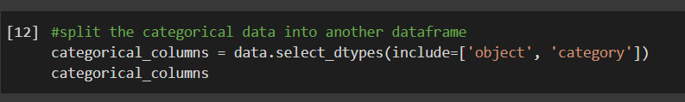
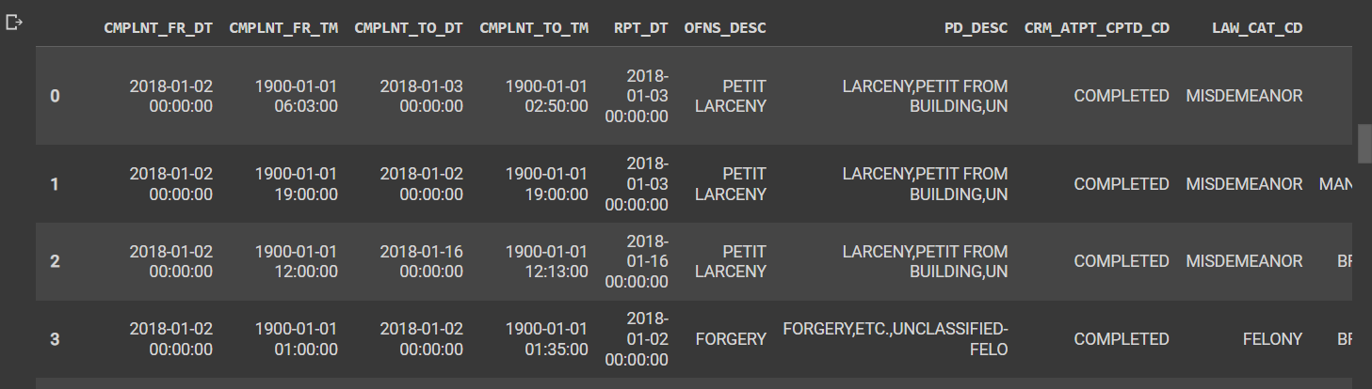
Separating categorical data

Slide 10
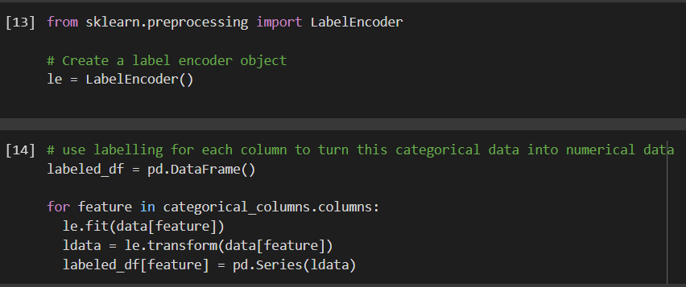
Labeling Categorical Data

Slide 11
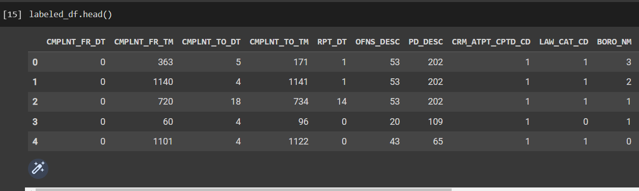
Labelled Data

Slide 12
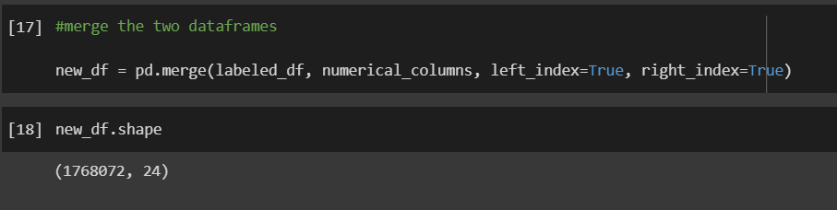
Merging data

Slide 13
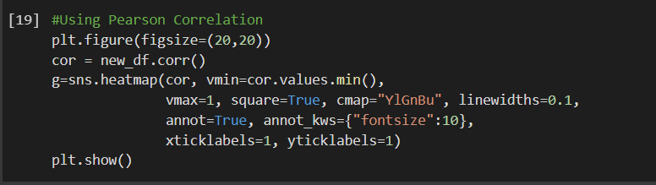
New Heatmap

Slide 14
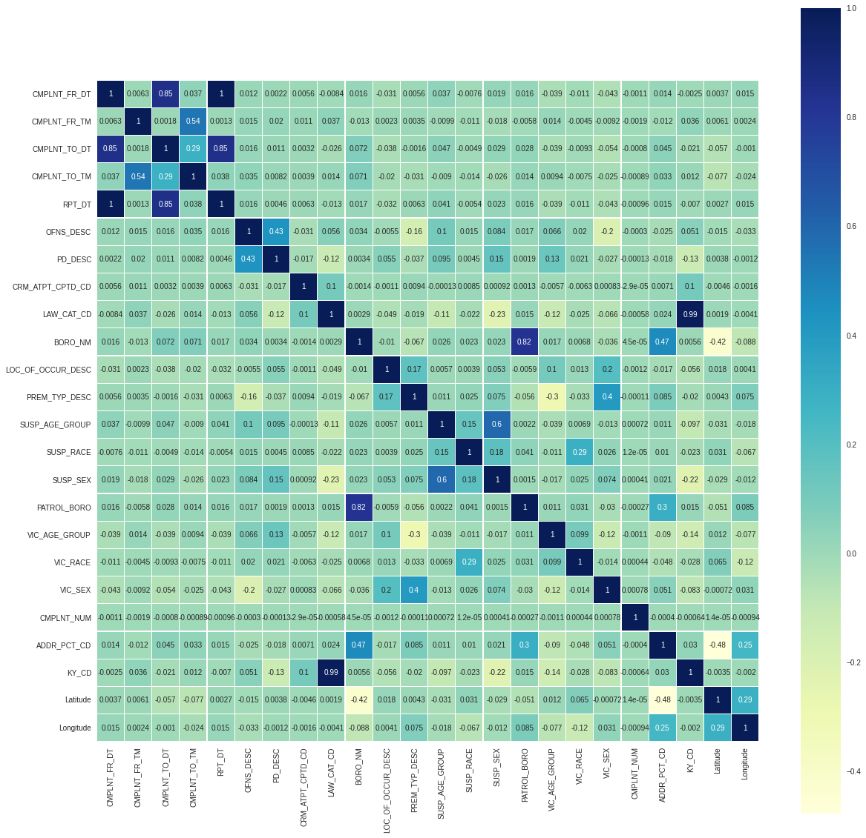

Slide 15
Classifying Main Offense Type

Slide 16
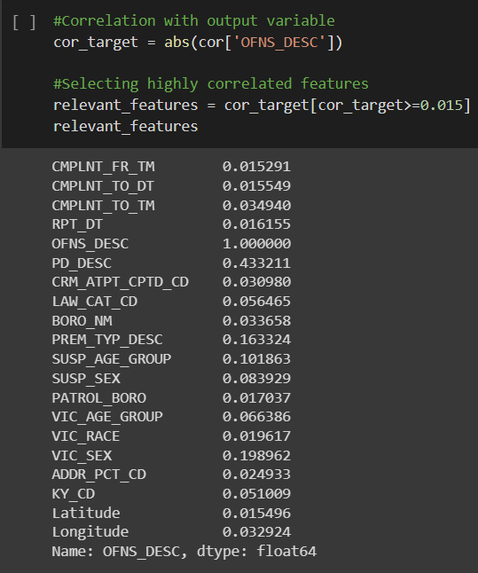
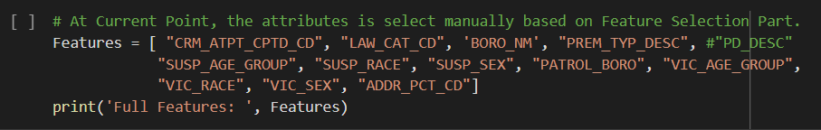
Feature Selection

Slide 17
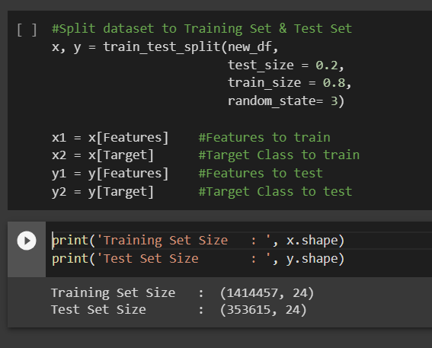
Splitting training and testing data

Slide 18
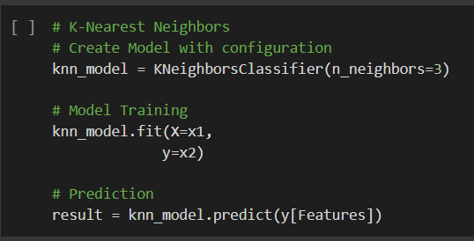
Running KNN model

Slide 19
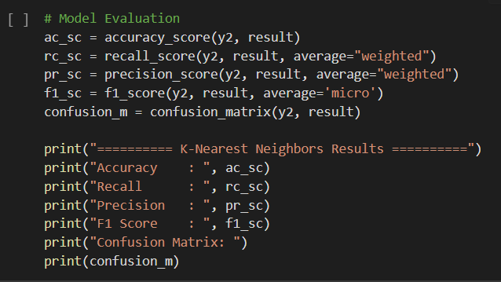
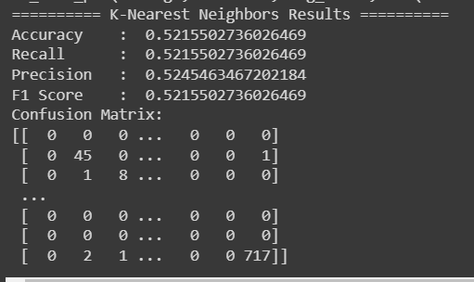
Model Scores

Slide 20
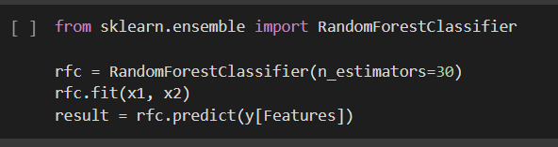
Running Decision tree (random Forest)

Slide 21
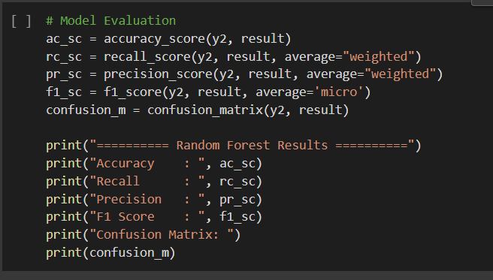
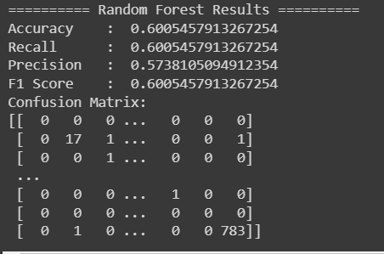
Model Scores

Slide 22
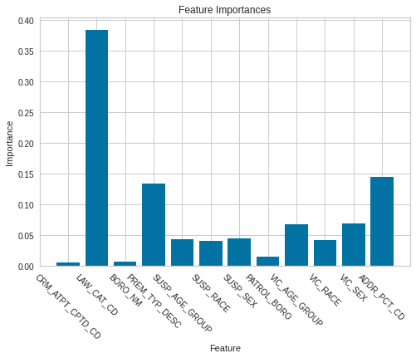
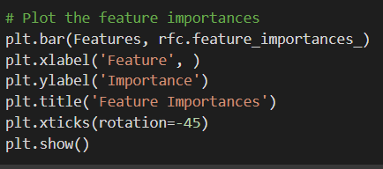
Feature Importance

Slide 23
Predicting the Boroughs where the crime took place

Slide 24
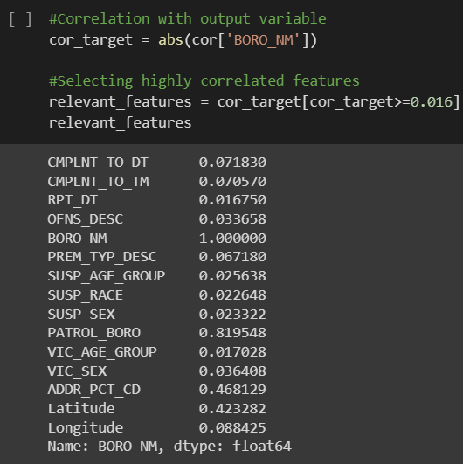
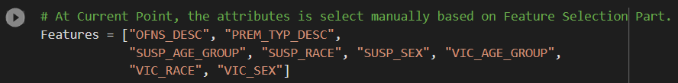
Feature Selection

Slide 25
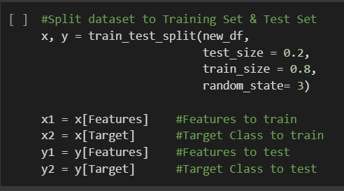
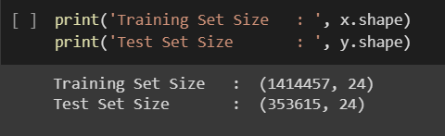
Splitting the data into test and train splits

Slide 26
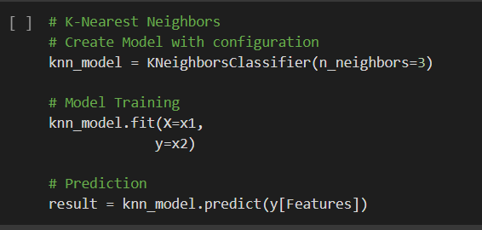
Training the KNN model

Slide 27
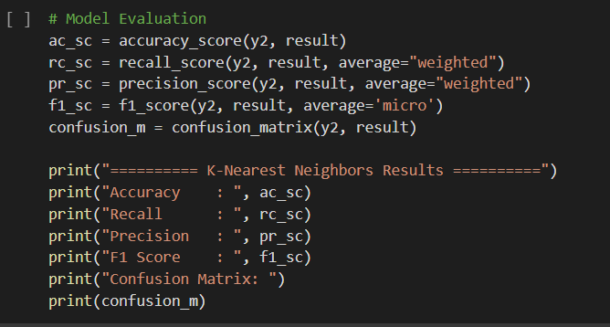
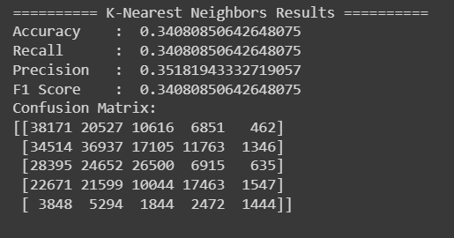
Model Evaluation

Slide 28
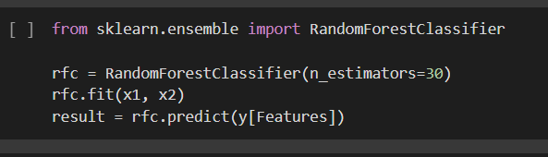
Training Decision Trees (random forest)

Slide 29
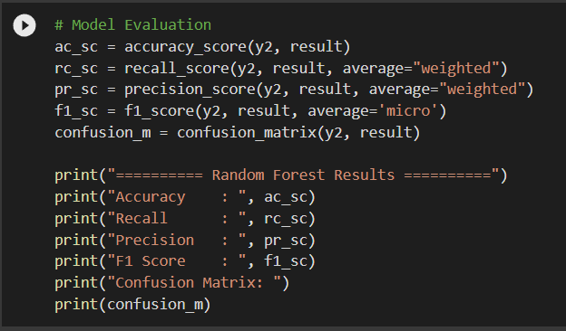
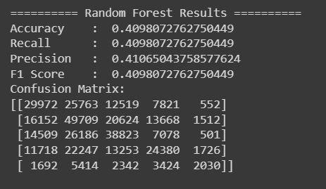
Model Evaluation

Slide 30
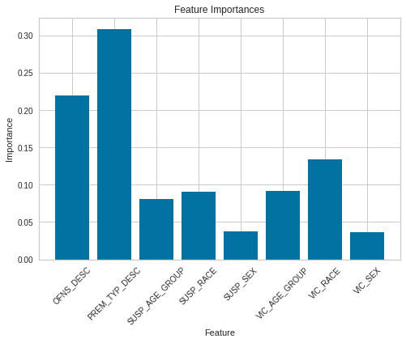
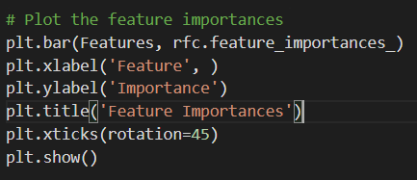
Feature Importance

Slide 31
Final Thoughts
The features in our dataset are not correlated enough
The selected features not intuitive enough
We might get more accurate results if we used other classification methods like SVMs or Neural Networks
Find additional data for recognizing more intuitive data

Slide 32
Thank you

